Slide 1

WEB Development Basics
InConcept Labs Learning series
HTTP Protocol

Slide 2
Agenda
Network protocols
OSI Model
Client server communication model
Key concepts
HTTP Request
HTTP Response

Slide 3
What is a Network Protocol
Simply, a protocol is a set of rules.
Network protocols are sets of established rules that dictate how to format, transmit and receive data so computer network devices -- from servers and routers to endpoints -- can communicate regardless of the differences in their underlying infrastructures, designs or standards.

Slide 4
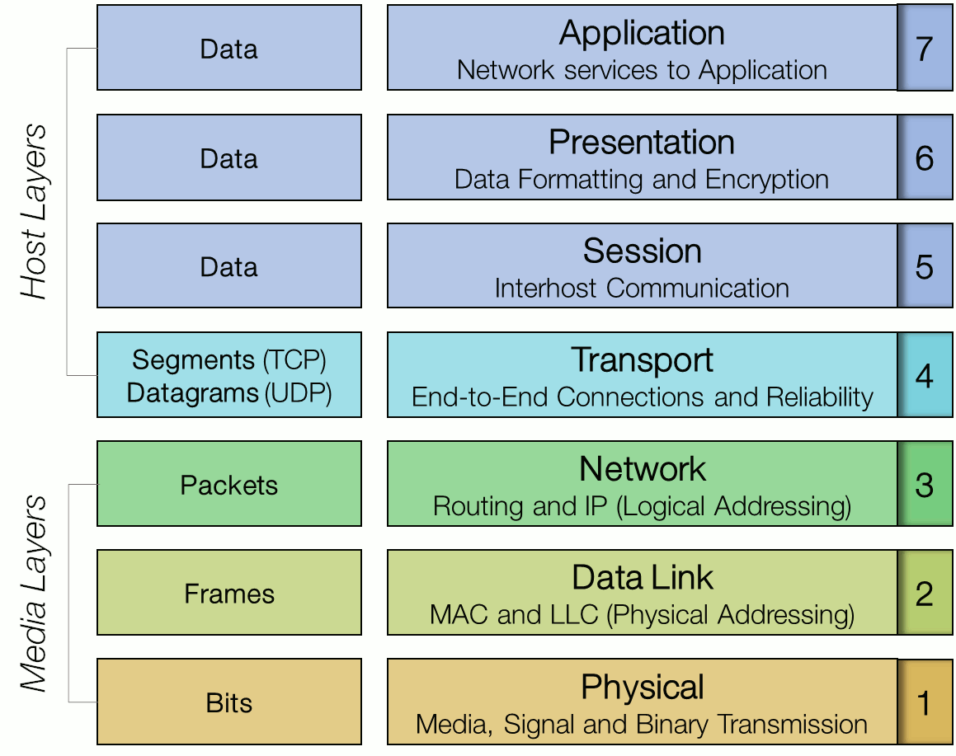
The OSI Model

Slide 5
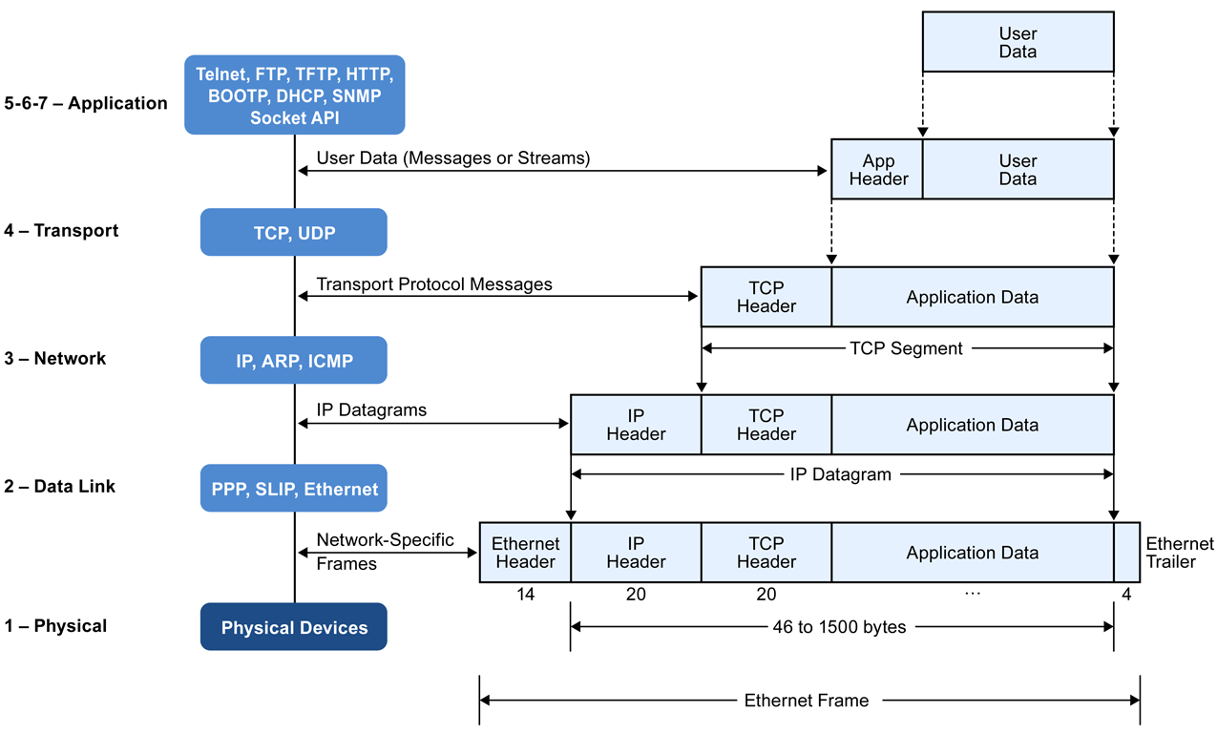
Protocol Stack

Slide 6
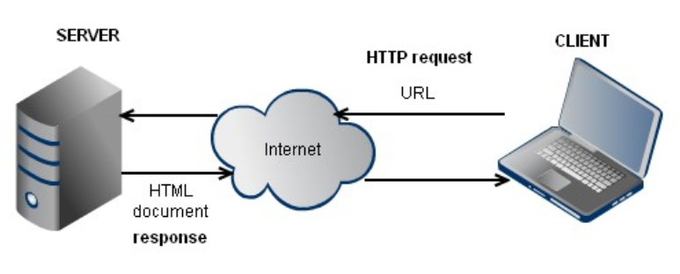
Client Server Model

Slide 7
Key Concepts
IP Address – numerical label assigned to each device participating in a computer network
DNS – domain name server
Port Number – 16 bit number
Socket – combination of IP address and port number

Slide 8
DNS – lookup
http://www.steves-internet-guide.com/dns-lookups/
Some queries to try on windows:
ipconfig/displaydns
ipconfig/flushdns

Slide 9
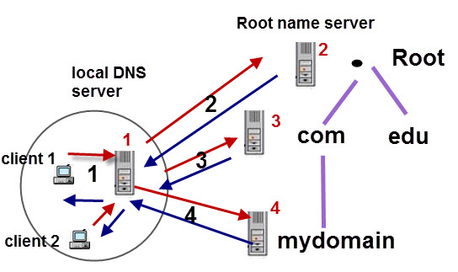
Domain Name Lookup Examples

Slide 10
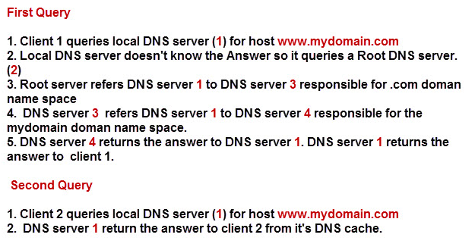
Domain Name Lookup Examples

Slide 11
URL structure
Wiki Definition
A uniform resource locator, abbreviated URL, also known as web address, is a specific character string that constitutes a reference to a resource
Syntax
scheme://domain:port/path?query_string#fragment_id
Default ports:
HTTP port – 80
HTTPS port – 443

Slide 12
URL parts example
http://video.google.co.uk:80/videoplay?docid=-7246927612831078230&hl=en#00h02m30s
The protocol is http
The host or hostname is video.google.co.uk.
The subdomain is video.
The domain name is google.co.uk.
The port is 80, which is the default port for web servers.
The path is /videoplay. Path typically refers to a file or location on the web server, e.g. /directory/file.html
This URL has parameters. The name of one parameter is docid and the value of that parameter is -7246927612831078230.Parameters start with a question mark (?) and are separated with an ampersand (&).
See the “#00h02m30s”? That’s called a fragment or a named anchor. Typically the fragment is used to refer to an internal section within a web document. In this case, the named anchor means “skip to 2 minutes and 30 seconds into the video.”

Slide 13
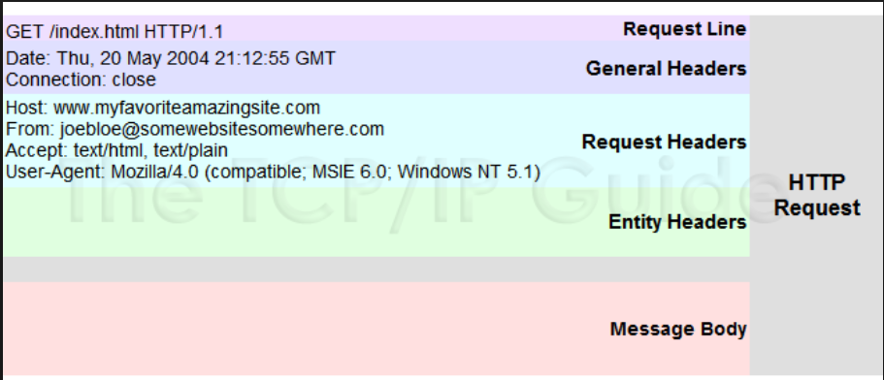
HTTP Request

Slide 14
HTTP Request Methods
GET requests a representation of the specified resource
HEAD retrieves meta information about resource (GET without body)
DELETE delete the resource specified in URL
POST requests that the server accept the entity enclosed in the request
PUT requests that the enclosed entity be stored under the supplied URI
PATCH applies partial modification to a resource
OPTIONS returns the HTTP methods that the server supports for the specified URL
TRACE requests changes or additions have been made by intermediate servers
CONNECT converts the request connection to a transparent TCP/IP tunnel
*safe methods

Slide 15
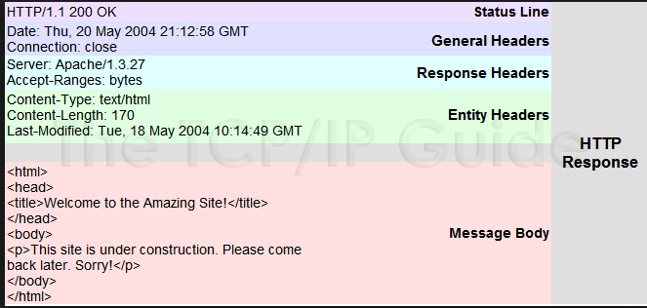
HTTP Response

Slide 16
HTTP Response Status Codes
Status code is always the first line of Response body
1xx Informational
(100 Continue, 101 Switching Protocols )
2xx Success
(200 OK, 201 Created, 202 Accepted, 204 No Content )
3xx Redirection
(301 Moved Permanently, 303 See Other, 304 Not Modified)
4xx Client Error
(400 Bad Request, 401 Unauthorized, 403 Forbidden, 404 Not Found)
5xx Server Error
(500 Internal Server Error, 501 Not Implemented, 503 Service Unavailable)

Slide 17
HTTP is Stateless
HTTP is stateless protocol
HTTP Server maintains no information about the clients
HTTP Client is always initiating the connection
TCP, FTP, SMTP are stateful protocol examples

Slide 18
Thank you

